Slide 1
Presented By : ERUM SABIR BSCS F19 M51 7th Morning B topic: Teaching SPM using Project Based Learning and group projects (By Jeremy Straub, Scott Kerlin , David Whale) Year 2017

Slide 2
introduction
PROJECT BASED LEARNING
Project-Based Learning is a teaching method in which students gain knowledge and skills by working for an extended period of time to investigate and respond to an authentic, engaging, and complex question, problem, or challenge.
The need for computer science undergraduate program students to have project management skills is becoming apparent.
While some projects fail due to purely technical considerations, many also suffer from project management issues.

Slide 3
LITERATURE REVIEW
YEAR | AUTHOR | METHOD | DISCUSSION/CONCLUSION
2003 | Mark Keil, Member, IEEE, Arun Rai, Joan Ellen Cheney Mann, and G. Peter Zhang | Logistic regression was applied to model the relationship between various project management constructs and project escalation.The model was then evaluated for its ability to correctly classify the projects. | The results of our research suggest that a logistic regression model based on project management constructs is capable of discriminating between projects that escalate and those that do not.
2008 | Paul L. Bannerman | The analysis is supported by a study of risk practices in government agencies in an Australian State, contributing to a gap in research in the public sector | It is concluded that risk management research lags the needs of practice, and risk management as practiced lags the prescriptions of research.
2003 | YARON DOPPELT | Analysis of pupils’ portfolios, observations of class activities, interviews with pupils, teachers and school management, achievements in the matriculation examinations, and assessment of pupils’ projects. | The findings indicate that scientific-technological PBL elevated pupils’ motivation and self-image at all levels and achieved significant affective learning.

Slide 4
YEAR | AUTHOR | METHOD | DISCUSSION/CONCLUSION
2014 | Jeremy Straub 1 and David Whalen | Participants in the Open Orbiter Small Spacecraft Development Initiative at the University of North Dakota were surveyed at the beginning of an academic year to determine why they were planning to participate in the program again or join and participate for the first time. | It has demonstrated that students seek specific benefits from their participation and suggested that these benefits are being delivered due to the correlation between the expectations of prior and new participants.
2013 | allow easy scaling of the class for a large number of students and might facilitate a distance learning environment | By combining simulation-based laboratory assignments, it was observed how to teach a robotics class with a limited amount of hardware to a large audience , student assessment | Making experimentation on hardware contingent on successful completion of simulation experiments allow easy scaling of the class for a large number of students and might facilitate a distance learning environment

Slide 5

methodology
Historic Approach
The first approach was very ill-defined.
little mentoring was provided
Second Approach
Students selected a spacecraft program software team and acted as a project management consultant to the team lead.
Third Approach
Students participating in this format were also responsible for implementing the work that they managed

Slide 6
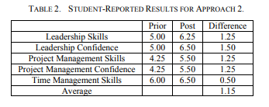

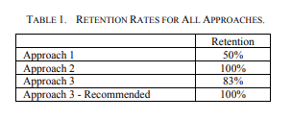
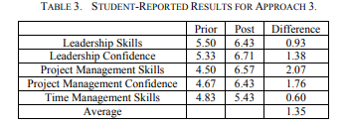

Discussions

Slide 7
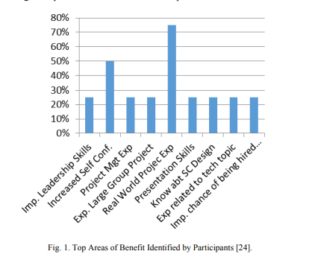

Slide 8
conclusion
This paper has presented a project-based learning approach to teaching software project management
It has considered three ways to provide students with hands-on skills in this area and compared them in terms of retention, student perception of their skills and confidence and tested performance.
All three approaches provided significant opportunities for students to learn and internalize knowledge and skills from actually performing project management.
However, the retention levels between approach 1 and those from approaches 2 and 3 show the importance of imposing greater structure on participants.
Future work will focus on the longer-term impact of participation in this course and the utility of the concepts presented in both future academic work and in the students’ career entry.

Slide 9
Thank you for your attention
The end

